Slide 1

ML 24/25-10 Creating Text from images with OCR API
Presented By
Karthik Prabu Natarajan (1564587)
Examined By
Prof. Dr. Damir Dobric
Prof. Dr. Andreas Pech

Slide 2
Agenda
3. Methodology
4. Implementation
5. Results and Analysis
6. Conclusion
1. Objective
7. Future Work
2. Introduction

Slide 3
1. Objective
Develop a C# console application utilizing the Tesseract SDK to preprocess images and perform OCR text extraction.
Evaluate and compare the effectiveness of various preprocessing techniques, providing a detailed output of the text extraction quality.

Slide 4
2. Introduction
What is OCR?
Converts images, scanned documents, or PDFs into editable text
Challenges in OCR:
Poor image quality, complex layouts, non-standard fonts
Research Focus:
Evaluating 24 different preprocessing techniques for improving OCR accuracy

Slide 5
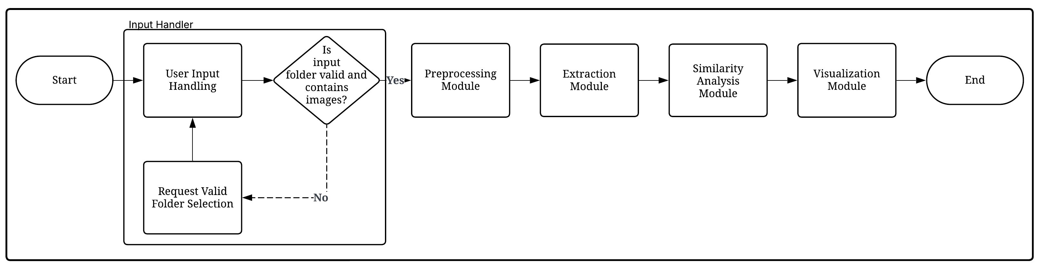
3. Methodology
Figure 1: Basic Architecture of the Application
System Architecture
Input handler: Manages folder paths, preprocessing methods, and various export formats for image processing.
Preprocessing Module: Processes input images and applies different image transformation techniques to enhance the images
Extraction Module: Extracts text from Images with multiple engine support, generate synthetic ground truth
Similarity Analysis Module: Implements text similarity metrics to evaluate OCR quality
Visualization Module: Generates Excel-based heatmaps and charts for performance visualization

Slide 6
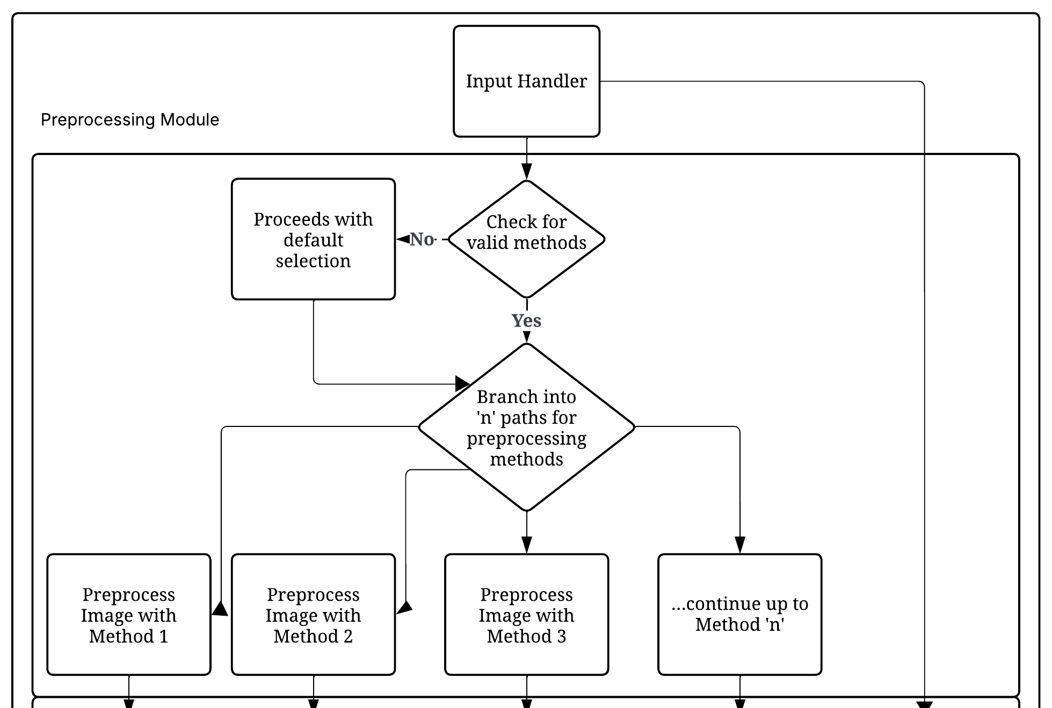
4. Implementation
Pre-Processing Module
Categories of Preprocessing Methods
Noise Reduction: Gaussian, Median, bilateral filtering
Binarization: Otsu’s method, adaptive thresholding
Geometric Adjustments: Deskewing, rotation, scaling
Morphological Operations: Dilation, erosion, opening, closing
Intensity Adjustments: Histogram equalization, gamma correction, Brightness Reduction, Log Transform
Figure 2: Architecture of Preprocessing Module

Slide 7
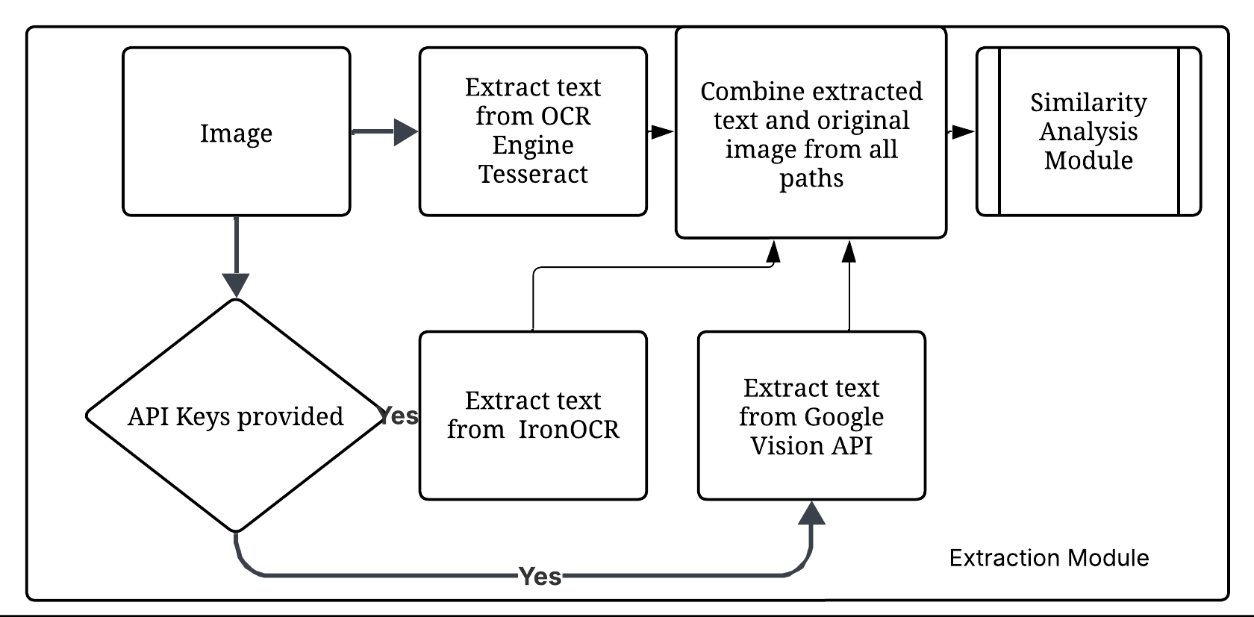
4. Implementation
Extraction Module
Key Feature - Ensemble OCR for Synthetic Ground Truth
Primary Approach: LLM-based text merging via API calls
Sends all OCR results to specialized endpoint
Leverages advanced language models to analyse and merge results
Applies linguistic knowledge to correct errors
Produces coherent and accurate text output
Extraction Engines Used:
Tesseract: (Open-source, on-device).
IronOCR: (High accuracy, .NET-based).
Google Vision API: (Cloud-based, deep-learning).
Fallback Mechanism: Enhanced majority voting algorithm
Text normalization (standardizing whitespace, removing special characters)
Length filtering (removing very short OCR results)
Line-by-line processing (identifying most common version)
Word-level frequency analysis (selecting most common words)
Text reconstruction (recombining selected words and lines)
Figure 3: Architecture of Extraction Module

Slide 8
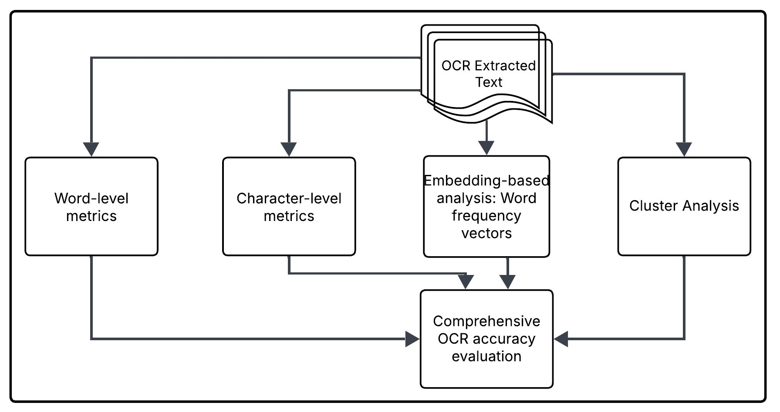
4. Implementation
Similarity Analysis Module
Evaluation Metrics
Word-level Similarity: Measures the semantic similarity between individual words based on context or meaning.
Character-level Similarity: Compares text based on the similarity of characters, useful for spelling variations or typos.
Embedding Generation: Transforms words, phrases, or sentences into numerical vectors to capture semantic meaning for machine learning tasks.
Clustering Analysis: Groups similar data points or objects together based on shared characteristics, often used for pattern recognition.
Figure 4: Architecture of Similarity Analysis Module

Slide 9
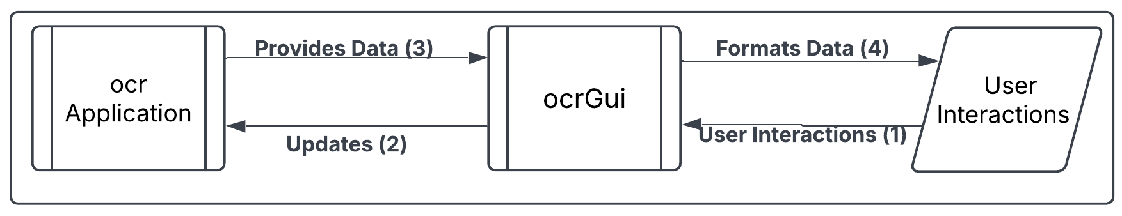
4. Implementation
Graphical User Interface Module
Provides Graphical User Interface for the OCR Application
Key Features
Provides only UI Interface
MVVM for logic.
Easier maintenance and testing.
Cleaner code organization.
Figure 5: Architecture of OCR Graphical User Interface Module

Slide 10
5. Result and Analysis
Text Similarity Metric Analysis
Cosine Similarity: Best for word-level accuracy.
Jaccard Similarity: Effective for preserving vocabulary in structured documents (e.g., invoices).
Levenshtein Similarity: Best for character-level accuracy in text-heavy documents with noise reduction.
Jaro-Winkler Similarity: Worked well for form fields and labels.
Clustering-Based Preprocessing Selection
Used unsupervised clustering (K-Means, PCA) to group preprocessing methods.
78% agreement between clustering-based selection and similarity metric ranking.
Helped automate the best preprocessing choice based on document characteristics.
Figure 5: Sample Similarity Summary for an Image

Slide 11
5. Result and Analysis
Performance Metrics
Processing Time
Optimized preprocessing led to a 52% reduction in processing time. Some techniques were significantly faster, while complex processes required more time and resources.
Fastest: Grayscale Conversion - A lightweight operation that quickly converts images to grayscale, reducing unnecessary colour data (42-60ms per image).
Moderate: Adaptive Thresholding – Enhances contrast for better OCR readability, balancing speed and accuracy (55-80ms per image).
Slowest: Deskewing - Involves computational geometry operations to correct text alignment, increasing processing time (98-140 ms per image)
Memory Usage
Preprocessing methods varied in memory consumption, with simpler techniques using less memory and more complex methods requiring higher resources.
Low: Grayscale & – Requires minimal processing, using 12-18MB per image.
Moderate: Edge Detection – Applies convolution-based filtering to detect boundaries, increasing memory usage to 25-32MB per image.
High: Deskewing & Rotation – Performs geometric transformations requiring additional buffer storage (38-45MB per image).
Very High: Multi-step Preprocessing – Combines multiple transformations (e.g., noise reduction, binarization, geometric corrections), significantly increasing memory usage to >70MB per image.
Note: Processing times and memory usage may vary depending on system configuration and image complexity.

Slide 12
6. Conclusion
Versatile Prototype: Developed a solution to compare 24 image preprocessing techniques for optimal method selection.
Multi-Engine OCR Integration: Supported Tesseract OCR, IronOCR, and Google Cloud Vision, ensuring flexibility and robustness.
LLM Integration: Leveraged a Large Language Model for synthetic ground truth generation, , with a fallback method in case LLM is unavailable.
Advanced Functionality: Incorporated word-level, character-level, and clustering functions for accurate differentiation and model selection.
Robustness & Reliability: Consistently identified optimal preprocessing techniques for various image datasets, with comprehensive unit tests.
Comprehensive Test Coverage: Implemented detailed test cases, including edge cases, to ensure accuracy and reliability of the system.
Optimized for Bulk Data: Demonstrated strength in comparing and optimizing preprocessing for large-scale image datasets.

Slide 13
7. Future Work
The project acknowledges certain limitations, particularly in its initial scope focused on meeting specific project requirements.
The future work for this project includes several key areas for improvement and expansion. These efforts aim to optimize the OCR solution, enhance scalability, and provide a more efficient user experience. The proposed future work includes:
Optimize OCR performance by refining image preprocessing techniques and exploring advanced algorithms to improve text extraction accuracy.
Enhance application scalability and responsiveness to efficiently handle larger datasets and diverse image types.
Extend compatibility with additional platforms to broaden the application's usability. (e.g., Expand support for mobile OCR applications).
Integrate machine learning models for adaptive preprocessing to improve accuracy and adaptability.
Deploy the application on a server to reduce the load on user systems and provide a more efficient user experience.
Improve overall versatility, accuracy, and robustness for real-world OCR tasks, pushing the boundaries of image processing capabilities.

Slide 14
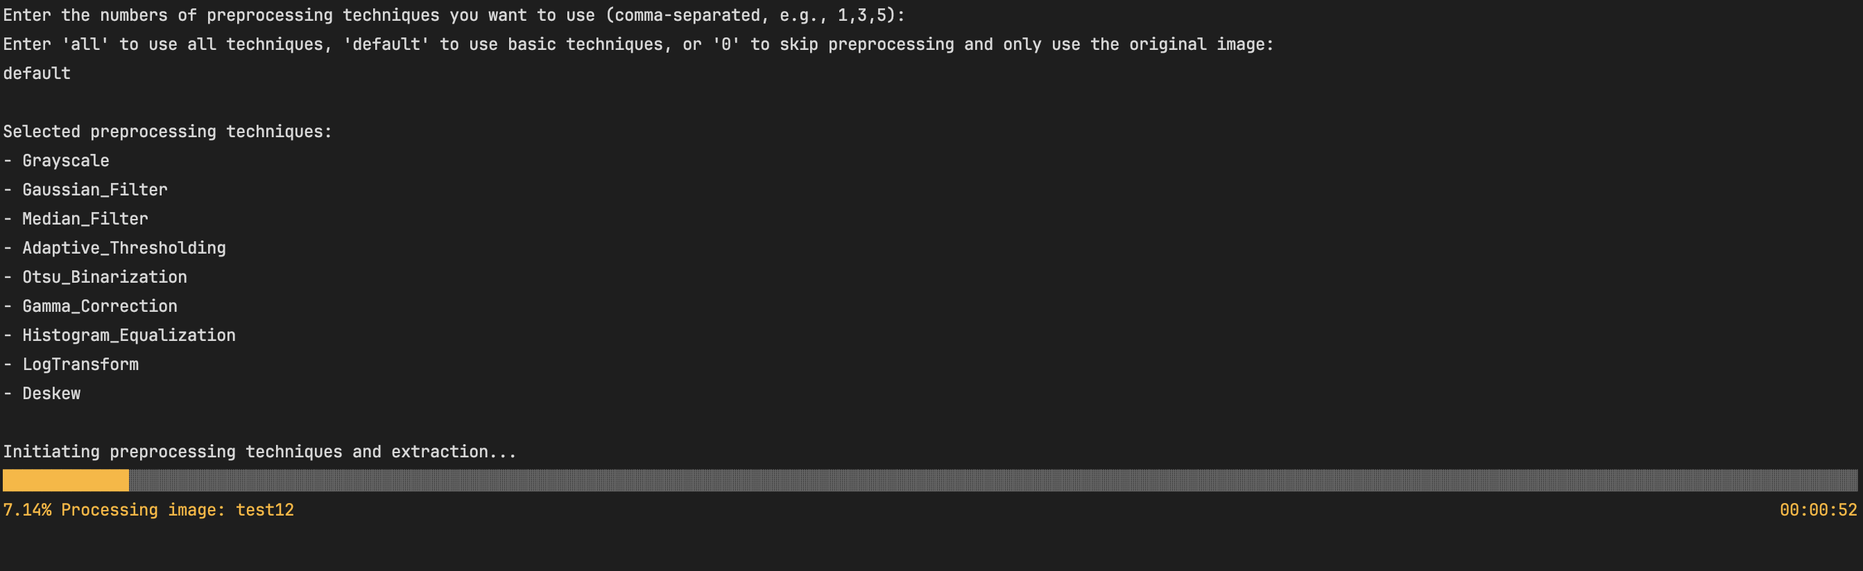
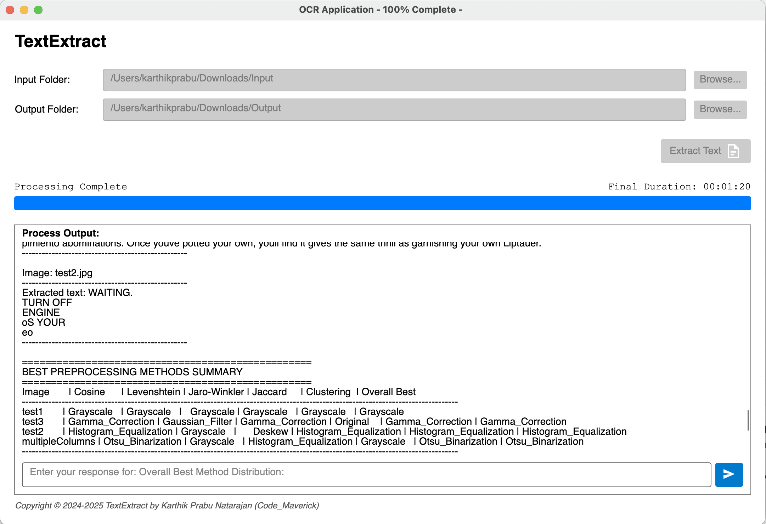
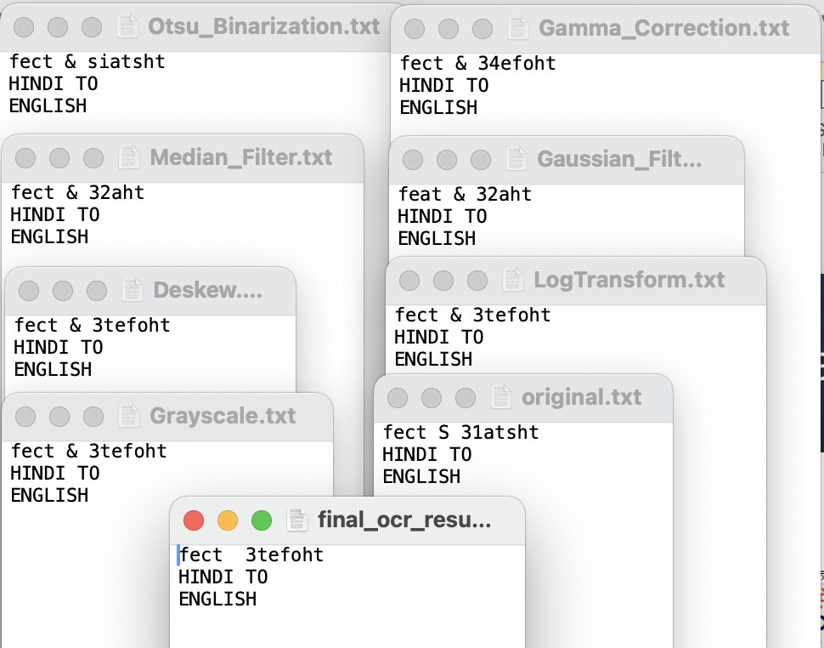
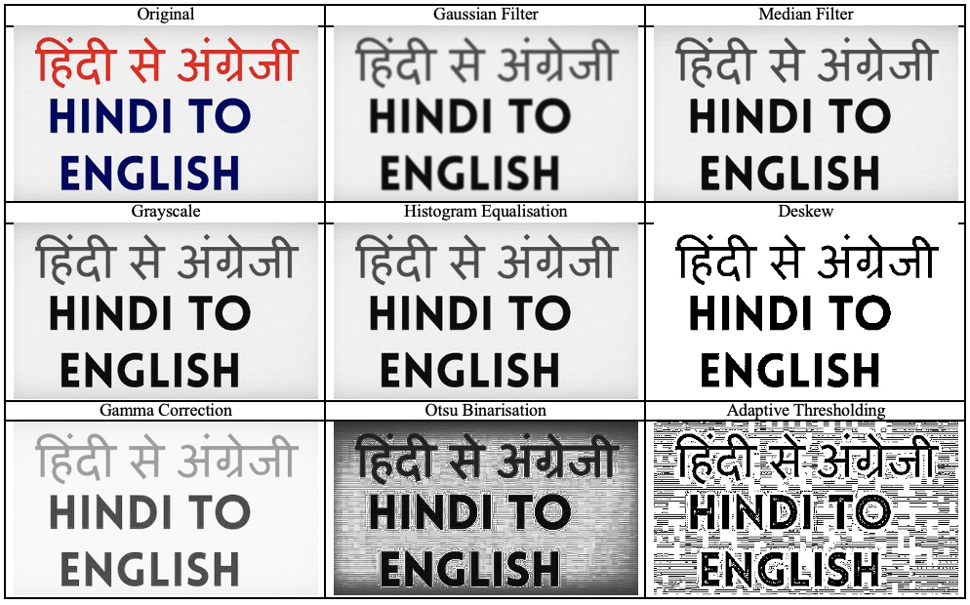
Output Screenshots
And
Demo
Figure 6: Command Line Interface
Figure 6: Graphical User Interface
Figure 7: Extracted Text from different image processing techniques
Figure 8: Original Image and Image after applying different Processing techniques

Slide 15

Thank You

